Slide 1
COMP 249: Programming Methodology
Graphical User Interfaces
(Chap. 17 & 18)

Slide 2
Menu
Introduction to GUIs
  Containers & Components
  Event-driven programming
  Layout Managers

Slide 3

Intro to GUIs
Graphical User Interface
Consists of a collection of components or widgets drawn to the screen
Usually interactive to some degree
Fun to build ☺ but sometimes frustrating ☹
by the way… what's a widget?

Slide 4
Origin
Abstract Window Toolkit (AWT) - java.awt
  Original GUI toolkit in JDK 1.1
  Basic GUI and drawing facilities
  Many components are heavyweight: Rely heavily on native GUI libraries of the operating systems
SWING - javax.swing
  Portable GUI toolkit added in Java 2, extending java.awt
  most components are lightweight: do not rely on OS (no native code required)
    100% implemented in Java code
    Leads to more consistency across platforms
  Gives platform-independent operation, but it is slower
Many other third party GUI toolkits,
  e.g., SWT in Eclipse.

Slide 5

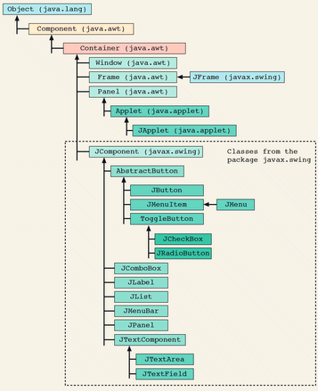
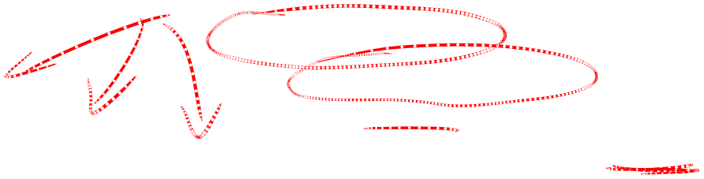
AWT and Swing
Swing GUI components start with J
  java.awt.Button --> javax.swing.JButton
  java.awt.Component --> javax.swing.JComponent
  java.awt.Panel --> javax.swing.JPanel
use Swing classes if possible

Slide 6
Graphical User Interfaces
A Graphical User Interface (GUI) uses:
  components & containers
  events & listeners

Slide 7
Containers and Components
Components
  are the widgets that make up the interface
  i.e. screen element to display information or allow the user to interact with the program
    ex: buttons, text fields, labels, menus, etc.
Containers
  are special components that can hold and organize other components
  Forms a containment hierarchy
    ex: dialog boxes, applets, frames, panels, etc.

Slide 8

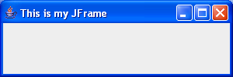
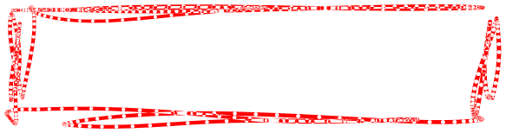





The basic approach
We start with a top-level container (can be displayed without being embedded inside another container)
  JFrame
    most common
    represents basic application window
  JApplet
    to see later
  JWindow
    no title bar or buttons
  JDialog
    usually to create custom dialogs

Slide 9
JFrame (SimplePanel.java)
Doesn’t do much by itself
Basic structure:
import javax.swing.*;
public class SimplePanel {
public static void main (String[] args) {
// Create the frame
JFrame myFrame = new JFrame("This is my JFrame");
// Optional: specify what happens when the frame closes
myFrame.setDefaultCloseOperation (JFrame.EXIT_ON_CLOSE);
// Optional
myFrame.setSize(300,100);
// mandatory if you want to see anything
myFrame.setVisible(true);
}
}
300= width
100= height

Slide 10
JFrame and Content Panes
a JFrame contains something called a content pane.
The content pane
  is where we add other containers or components
    ex: buttons, text fields, …
JFrame frame = new JFrame("My title");
frame.getContentPane().add(component); // older Java
or
frame.add(component);

Slide 11




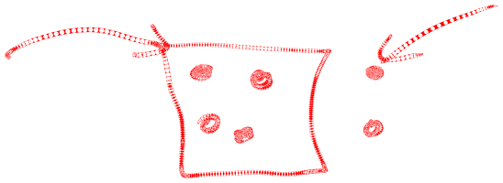
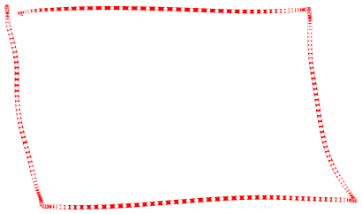
Creating a panel - JPanel
A JPanel doesn’t do much by itself either
It’s a blank container object - an empty area that can be used to
  Draw graphics on
  Layout other components or containers
    i.e. to group things together and lay them out nicely
    Use the add() method to insert individual components
    Basic idea:
      Create one or more widgets
      Add them to a panel
      Add the panel to the JFrame

Slide 12
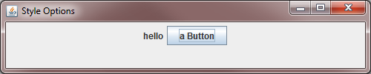
Example: SimpleCheckBox.java
public class SimpleCheckBox {
public static void main (String[] args) {
JFrame myFrame = new JFrame("Style Options");
myFrame.setDefaultCloseOperation(JFrame.EXIT_ON_CLOSE);
JPanel myPanel = new JPanel();
// create widgets
JLabel myLabel = new JLabel("hello");
JButton myButton = new JButton("a Button");
// add widgets to a panel
myPanel.add(myLabel);
myPanel.add(myButton);
// add the panel to the frame
myFrame.add(myPanel);
myFrame.setSize(500,100);
myFrame.setVisible(true);
}
}

Slide 13
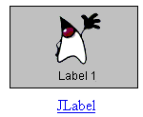
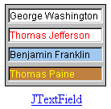
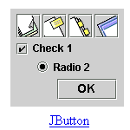
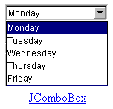
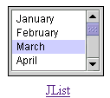
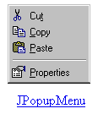
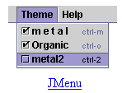

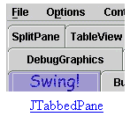
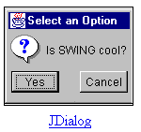
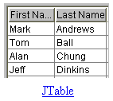

Useful Components (cool widgets)
JCheckBox, JRadioButton, JButton

Slide 14
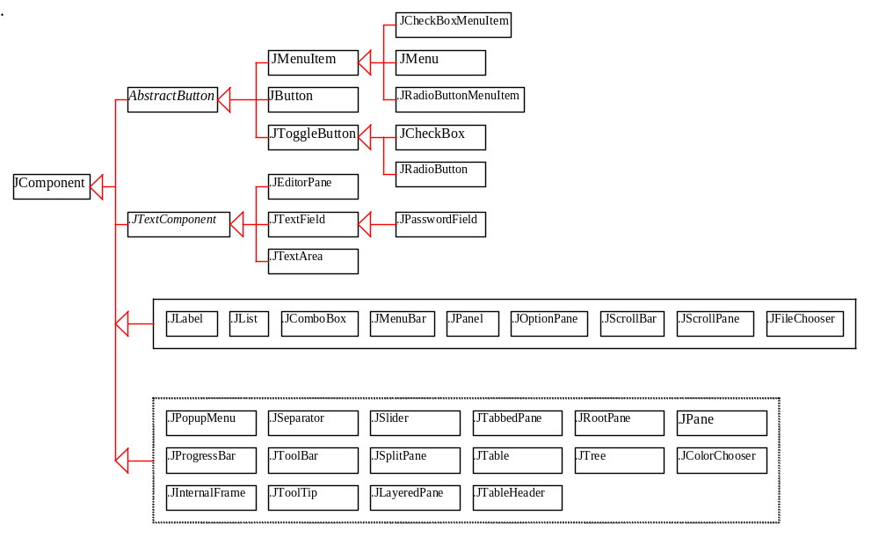
JComponent Hierarchy

Slide 15
Some JComponent Methods
Color getBackground()
Font getFont()
Color getForeground()
int getHeight()
boolean isEnabled()
boolean isLightweight()
void setVisible(boolean b)
void setFont(Font font)
…

Slide 16
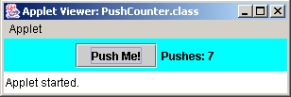
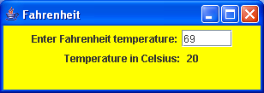
Example: JLabel
displays a single line of text (or an image, or both)
read-only (can be changed by application, but not by user)
defined by the JLabel class
many constructors
  JLabel myLabel = new JLabel("Pushes: ");
useful method: setText()

Slide 17
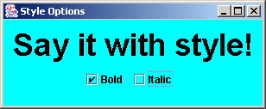
Example: JCheckBox
a button that can be toggled on or off
defined by the JCheckBox class

Slide 18
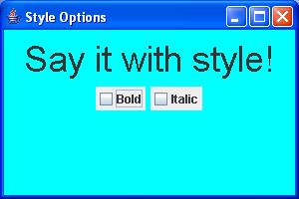
Example: StyleOptionsNoListener.java
import java.awt.*;
import javax.swing.*;
public class SimpleCheckBox
{
public static void main (String[] args)
{
JFrame frame = new JFrame("Style Options");
frame.setDefaultCloseOperation (JFrame.EXIT_ON_CLOSE);
StyleOptionsPanel panel = new StyleOptionsPanel();
frame.add(panel);
frame.setSize(300,150);
frame.setVisible(true);
}
}

Slide 19
class StyleOptionsPanel extends JPanel{
private JLabel saying;
private JCheckBox bold, italic;
public StyleOptionsPanel() {
saying = new JLabel ("Say it with style!");
saying.setFont (new Font ("Helvetica", Font.PLAIN, 36));
bold = new JCheckBox ("Bold");
italic = new JCheckBox ("Italic");
________________________
________________________
________________________
setBackground(Color.cyan);
setSize (300, 100);
}
}

Slide 20
Menu
Introduction to GUIs
  Containers & Components
  Event-driven programming
  Layout Managers

Slide 21
Event-Driven Programming (p. 943)
At the moment our widgets don’t do anything
  ex: PushCounter1.java, StyleOptionsNoListener.java
  we need events and listeners
Procedural programming is executed in procedural order.
  the program controls the flow
In event-driven programming, code is executed upon activation of events.
  the user controls the flow

Slide 22
Events
An event is an object that represents some activity to which we may want to respond
ex:
  the mouse is moved
  a mouse button is clicked
  the mouse is dragged
  a graphical button is clicked
  a keyboard key is pressed
  a timer expires
Events often correspond to user actions

Slide 23
Event Routing
Components fire events
ex:
Source Object Event Type
Generated
user clicked on a button………………………….JButton…………………………ActionEvent
user changed text ……………………………………JTextComponent TextEvent
(JTextArea, JTextField)
user double-clicked on a list item ………JList ………………………… ActionEvent
user selected or deselected an item……JList ………………………… ItemEvent
with a single click
user selected or deselected an item ……JComboBox ………………ItemEvent
…
When fired, events are routed to special Listener objects.

Slide 24
The Event Process
The programmer:
  creates an interactive widgets
    ex: Push buttons, Radio buttons, …
  creates a listener to handle the widget interaction
  registers the listener for the widget
When the user interacts with GUI:
  an event is generated
  Java looks for the registered listener
  Java passes an Event Object to the listener(s)
  The listener handles the request with programmer’s code

Slide 25

GUI Interaction
AWT Event Queue
Event
Button A Event
Test Application
X
Components
Button A
Actions generate Events
Button B Event
Button B
Lola clicks Button A, then Button B
Listener for Button A
X
Listeners
Listener for Button B

Slide 26
How to write a listener
Listeners are implemented with interfaces
Two implementation techniques
  Create a separate class for the listener
    most common
    using an inner class
  An existing component implements the interface
    Many widgets can register the same listener
    not recommended

Slide 27
Example: PushCounter2.java
First: let's move the frame's code in a new class
public class PushCounter2 {
public static void main(String[] arg) {
PushGUI myGui = new PushGUI();
}
}
class PushGUI extends JFrame{
private JFrame theWindow; private int nbPushes;
private JButton myButton; private JLabel myLabel;
private JPanel myPanel;
PushGUI(){
theWindow = new JFrame("Push Counter that counts!");
theWindow.setDefaultCloseOperation(JFrame.EXIT_ON_CLOSE);
nbPushes = 0;
myButton = new JButton("Push Me!");
myLabel = new JLabel("Pushes: " + Integer.toString(nbPushes));
myPanel = new JPanel();
theWindow.add(myPanel);
myPanel.add(myLabel);
myPanel.add(myButton);
theWindow.pack();
theWindow.setVisible(true);
}
}
1
2

Slide 28
Example: PushCounter3.java
import java.awt.event.*;
public class PushCounter3 { … }
class PushGUI extends JFrame{
private JFrame theWindow; private int nbPushes;
private JButton myButton; private JLabel myLabel;
private JPanel myPanel;
public PushGUI(){
theWindow = new JFrame("Push Counter that counts!");
…
myButton.addActionListener(new ButtonListener());
…
myPanel.add(myButton);
theWindow.pack();
theWindow.setVisible(true);
}
// the listener is an inner class
private class ButtonListener implements ActionListener {
public void actionPerformed (ActionEvent event) {
nbPushes++;
myLabel.setText("Pushes: " + Integer.toString(nbPushes));
}
}
}
Now: let's add the listener
1
2
3

Slide 29
Other Examples
Fahrenheit.java
StyleOptions.java

Slide 30
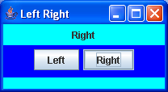
One Listener, many events…
If 1 listener can catch many events:
  you need to determine which event got fired
  event.getSource() returns the source
    as a reference to the object that got activated
  event.getActionCommand() returns the source
    as a string (ex. the label on the button, …)

Slide 31
Example: LeftRightCombined.java
public LeftRightCombinedPanel (){
left = new JButton ("Left");
right = new JButton ("Right");
// same listener for both buttons
ButtonListener listener = new ButtonListener();
left.addActionListener (listener);
right.addActionListener (listener);
…
}
private class ButtonListener implements ActionListener{
public void actionPerformed (ActionEvent event){
if (event.getSource() == left)
label.setText("Left");
else
label.setText("Right");
}
}

Slide 32
Example: LeftRightSeparate.java
public LeftRightSeparatePanel (){
left = new JButton ("Left");
right = new JButton ("Right");
// create separate listeners for each button
left.addActionListener (new LeftButtonListener() );
right.addActionListener (new RightButtonListener() );
…
}
// A listener for the left button.
private class LeftButtonListener implements ActionListener{
public void actionPerformed (ActionEvent event){
label.setText("Left");
}
}
// A listener for the left button.
private class RightButtonListener implements ActionListener{
public void actionPerformed (ActionEvent event){
label.setText("Right");
}
}

Slide 33
Selected Event Handlers
different components fire different events (have different listeners and methods):
Component EventClass ListenerInterface ListenerMethods
JButton ActionEvent ActionListener actionPerformed(ActionEvent)
JCheckBox ItemEvent ItemListener itemStateChanged(ItemEvent)
Window WindowEvent WindowListener windowClosing(WindowEvent)
windowOpened(WindowEvent)
windowIconified(WindowEvent)
windowDeiconified(WindowEvent)
windowClosed(WindowEvent)
windowActivated(WindowEvent)
windowDeactivated(WindowEvent)
Container ContainerEvent ContainerListener componentAdded(ContainerEvent)
componentRemoved(ContainerEvent)

Slide 34
Just for fun…
CoolMaze.java

Slide 35
Menu
Introduction to GUIs
  Containers & Components
  Event-driven programming
  Layout Managers

Slide 36
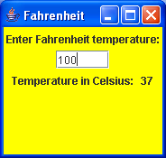
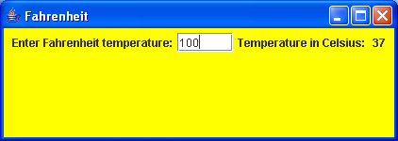
Layout Management (p.962)
Components are placed in containers
Each container has a layout manager to arrange the components within the container
so far, we had limited control over the layout of GUI elements
  by default, a panel uses flow layout (elements are left-to-right, wrap as needed)
Java has layout managers that can be used to place elements

Slide 37
Layout Managers (p. 946)
Java defines a number of “Layout Managers” to place elements where you want
or you can define your own
or import third party libraries
Flow Layout (default)
Border Layout
Card Layout
Grid Layout
GridBag Layout
Defined in the AWT
Box Layout
Overlay Layout
Defined in Swing

Slide 38
Layout Managers
Some layout managers pay attention to a component's preferred size or alignment, while others do not
use the setLayout() method of a container to change its layout manager
JPanel myPanel = new JPanel();
myPanel.setLayout(new BorderLayout());
add components accordingly

Slide 39
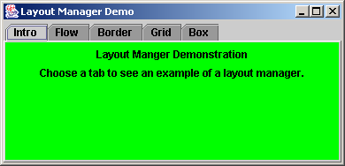
Example: LayoutDemo.java
import javax.swing.*;
public class LayoutDemo
{
public static void main (String[] args)
{
JFrame frame = new JFrame("Layout Manager Demo");
frame.setDefaultCloseOperation(JFrame.EXIT_ON_CLOSE);
JTabbedPane tp = new JTabbedPane();
tp.addTab("Intro", new IntroPanel());
tp.addTab("Flow", new FlowPanel());
tp.addTab("Border", new BorderPanel());
tp.addTab("Grid", new GridPanel());
tp.addTab("Box", new BoxPanel());
frame.add(tp);
frame.pack();
frame.setVisible(true);
}
}

Slide 40
Example (con't)
import java.awt.*;
import javax.swing.*;
public class IntroPanel extends JPanel {
public IntroPanel() {
____________________(Color.green);
JLabel l1 = new JLabel("Layout Manger Demonstration");
______________________("Choose a tab to see
an example of " + "a layout manager.");
add(l1);
add(l2);
}
}

Slide 41
Example: FlowLayout
import java.awt.*;
import javax.swing.*;
public class FlowPanel extends JPanel {
public FlowPanel () {
setLayout(new FlowLayout());
setBackground (Color.green);
JButton b1 = new JButton("BUTTON 1");
JButton b2 = new JButton("BUTTON 2");
JButton b3 = new JButton("BUTTON 3");
JButton b4 = new JButton("BUTTON 4");
JButton b5 = new JButton("BUTTON 5");
add(b1);
add(b2);
add(b3);
add(b4);
add(b5);
}
}

Slide 42
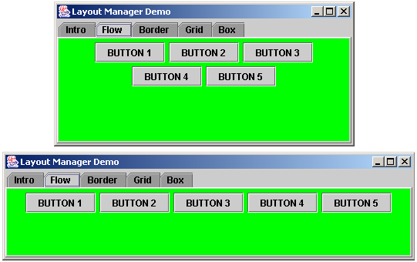
The FlowLayout Manager
FlowLayout is similar to word wrap in text
  Start adding in top centre
  Go onto next line if the line is full

Slide 43
The GridLayout Manager
Lays out things in a grid
GridLayout g = new GridLayout(2,4)); // (nbRows, nbCol)
panel.setLayout(g);
rows have same height and columns have same width
  Components are stretched to fit cell
Components are added 1 by 1
Automatically filled from top left to right
or you can specify which cell
panel.add(…);
panel.add(…);
panel.add(…);
panel.add(…);
panel.add(…);
panel.add(…);
0,0
0,1
0,2
panel.add(startButton, 0, 0);
panel.add(stopButton, 1, 1);
1,1
1,3

Slide 44
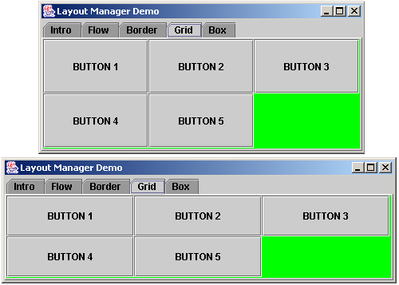
Example: GridLayout

Slide 45
Example: GridLayout
import java.awt.*;
import javax.swing.*;
public class GridPanel extends JPanel {
public GridPanel() {
setBackground (Color.green);
JButton b1 = new JButton ("BUTTON 1");
JButton b2 = new JButton ("BUTTON 2");
JButton b3 = new JButton ("BUTTON 3");
JButton b4 = new JButton ("BUTTON 4");
JButton b5 = new JButton ("BUTTON 5");
}
}

Slide 46
The BorderLayout Manager
Idea of borders:
The center area expands to fill space as needed
Specify location when adding components:
  BorderLayout b = new BorderLayout();
  panel.setLayout(b);
  panel.add(new JLabel(“North”),BorderLayout.NORTH);
  panel.add(new JLabel(“South”),BorderLayout.SOUTH);
  ...
NORTH
WEST
CENTER
EAST
SOUTH

Slide 47
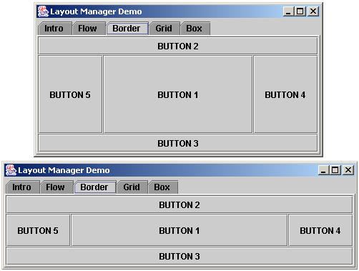
Example: BorderLayout

Slide 48
Containment Hierarchies
The way components are grouped into containers and the way those containers are nested within each other establishes the containment hierarchy for the GUI
Each container can have its own layout manager
The appearance of a GUI is determined by:
  the containment hierarchy
  the layout manager of each container
  the properties of individual components

Slide 49
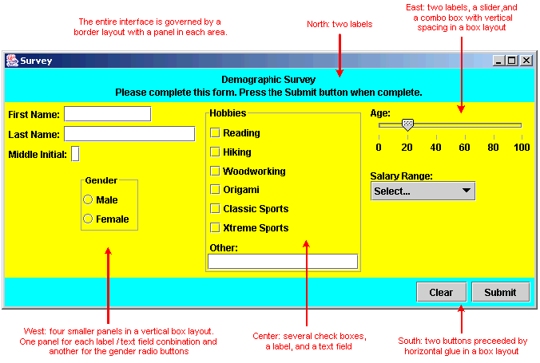
Containment Hierarchies

Slide 50


